Slide 1
Front End Engineering-I
Project
Team Details:
Name: Jiya Roll No.: 2210990463
Name: Jiya Gaba Roll No.: 2210990464
Name: Joel Matthew Roll No.: 2210990465
Name: Joyash Sood Roll No.: 2210990466
Faculty Coordinator: Dr. Chetna Kaushal
:
Chitkara University Institute of Engineering and Technology,
Chitkara University, Punjab
MAY,2023

Slide 2
Table of Contents:
Introduction
Problem Statement
Technical Details
Key Features
Project Highlights
Bonus Feature(optional)
Conclusion
References/Links used

Slide 3
Introduction-
Music Player Using JavaScript:
Team Members:
Name: Jiya Roll No.: 2210990463
Name: Jiya Gaba Roll No.: 2210990464
Name: Joel Mathew Roll No.: 2210990465
Name: Joyash Sood Roll No.: 2210990466
Overview Of The Project:
Music is one of the best ways to relieve pressure in stressful modern society life. The purpose of this project is to develop a player which can play the mainstream file format. Meanwhile, this software can play, pause and select songs with the help of buttons according to your requirement as well as set up songs.

Slide 4
Problem Statement-
Even though we have music player in our androids yet we require online streaming of songs? Why?
Problem:
Downloading each song can be pretty space consuming.
Creating albums according to our song requirements is time consuming.
Song range is limited.
Downloading songs can lead to virus threats.
Playlists created by user1 can’t be shared directly to some other user.
We cant find artists of our favourite genre
Playlist is not upto date.
Song management is not smooth

Slide 5
Technical Details-
Basic structure of the website was designed using HTML.
The styling and formatting of the site by done with the help of CSS.
Java Script (To be used) for the backend tasks for example storing music and all of the user data.
User Interface: Music players have graphical user interfaces (GUI) that allow users to interact with the player. The user interface can include features such as playlists and visualizations.
Audio Outputs: Music players use audio outputs such as speakers, headphones, and digital audio outputs to play back audio.
Storage Devices: Music players can store music files on various types of storage devices such as hard drives, solid-state drives, and memory cards.
Wireless Technologies: Music players can connect to other devices wirelessly using technologies such as Bluetooth and Wi-Fi.

Slide 6
Key Features-
Play, pause, and stop buttons: These buttons allow the user to control the playback of the music.
Progress bar: A progress bar indicates the current position of the music playback and how much time has elapsed.
Volume control: A volume slider allows the user to adjust the volume of the music.
Playlist: A playlist allows the user to select which songs they want to play.
Album artwork display: The music player can display the album artwork of the currently playing song.
Crossfade: Crossfade is the ability to fade out one song while fading in the next song, creating a smooth transition between the two.
Customizable themes: Users can change the appearance of the music player by choosing different themes or skins.

Slide 7
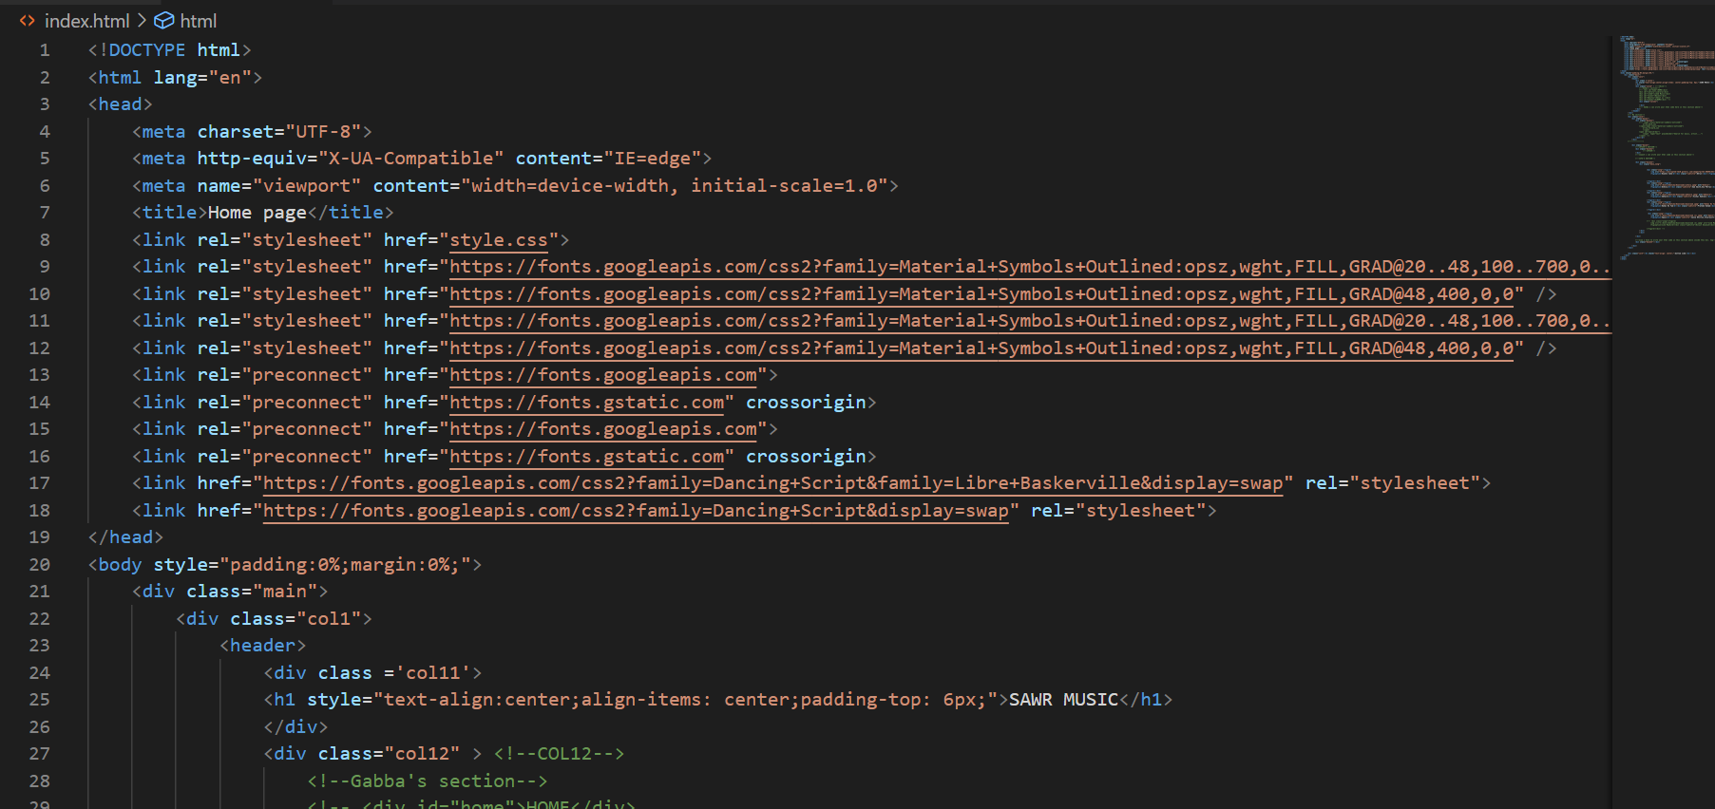
Project Highlights
HTML CODE:
HTML (Hypertext Markup Language) is a markup language used for creating web pages. It provides the structure and content of a web page, including headings, paragraphs, images, and links. In the project, HTML was used to create the layout of the countdown timer, including the placement and styling of the various elements such as the input fields and the countdown display.

Slide 8
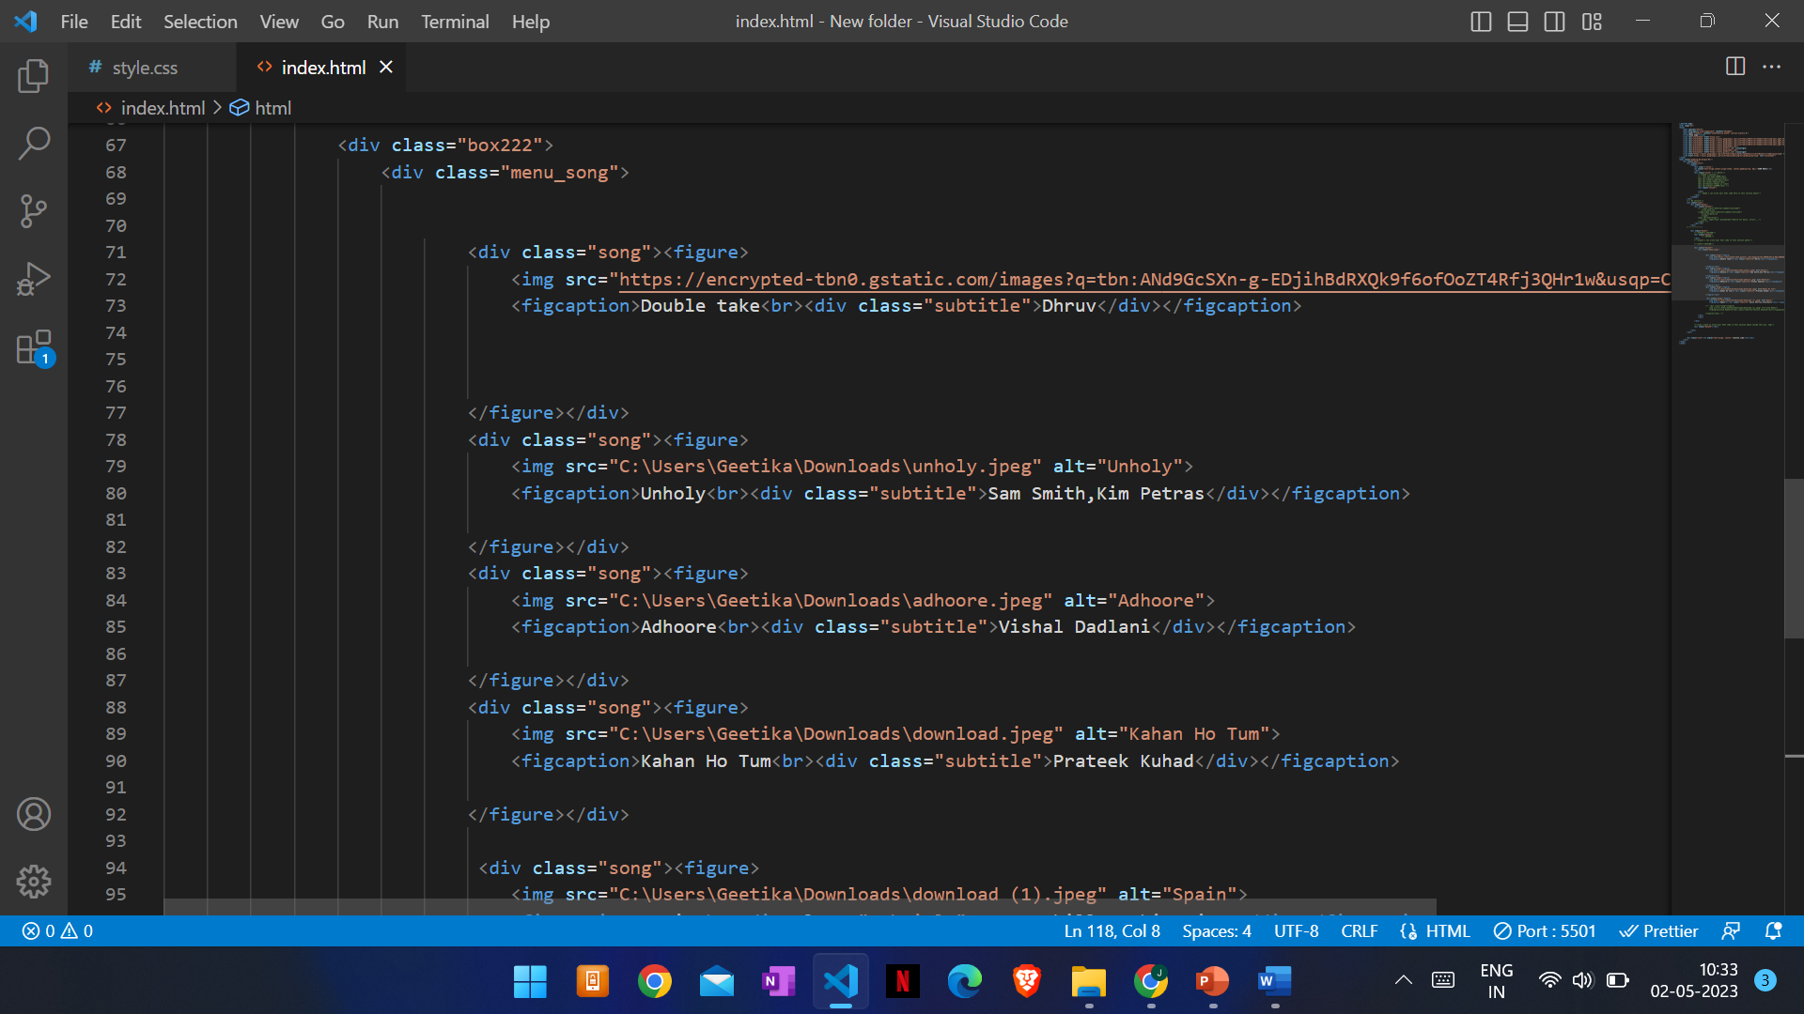
CSS CODE:
For styling the webpage we have used CSS. In CSS, firstly we have made universal style and added margin, padding and bot sizing. Then we styled a contain. In container, we’ve have used flex property for aligning the elements in centre, background colour, text colour and adjusted the width and height as per the requirement. In text area, we styled the font by using font size and font family. In output box division we added flex property space between and adjusted the width and height as per our need

Slide 9
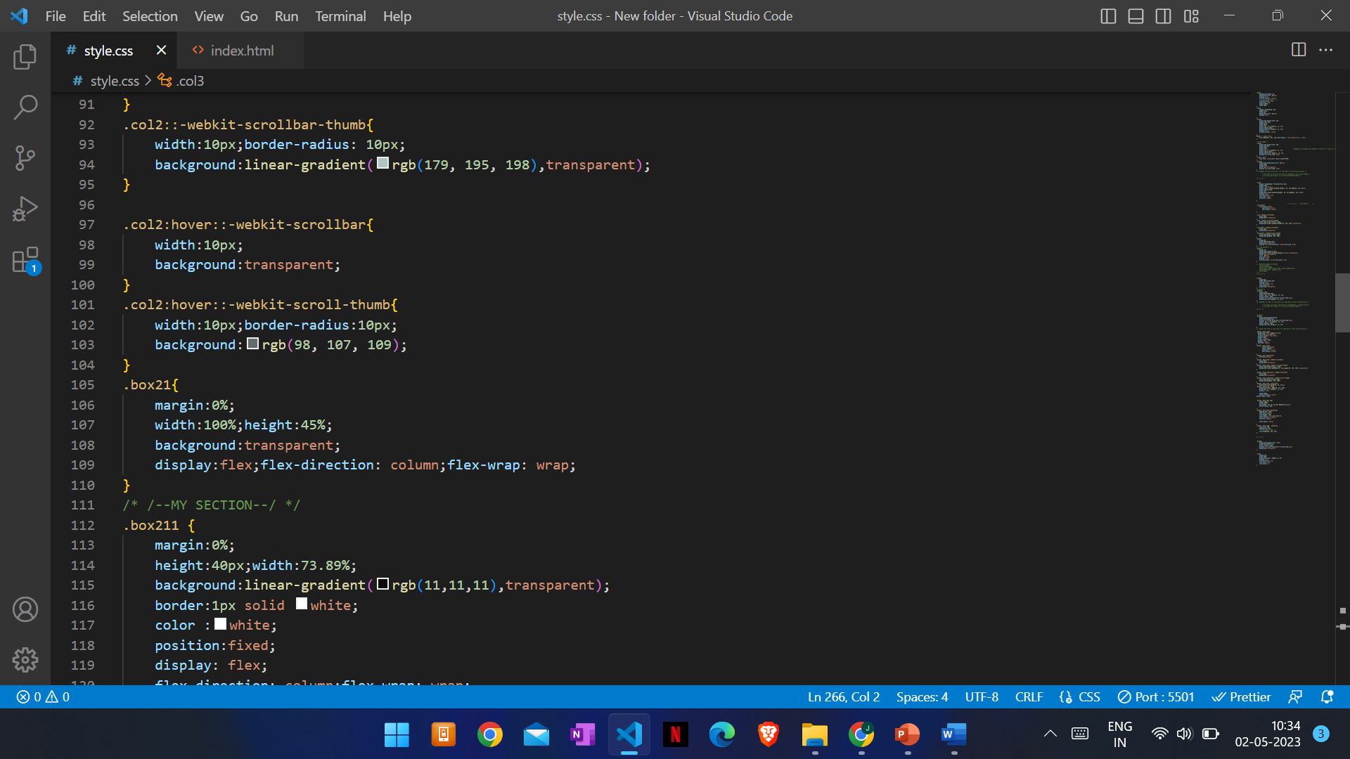
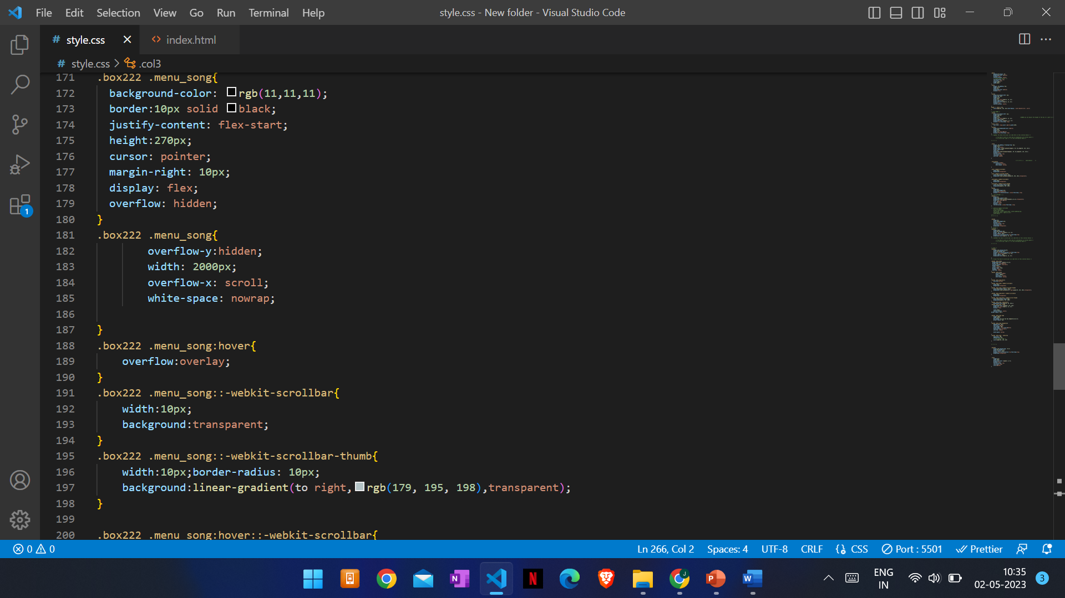
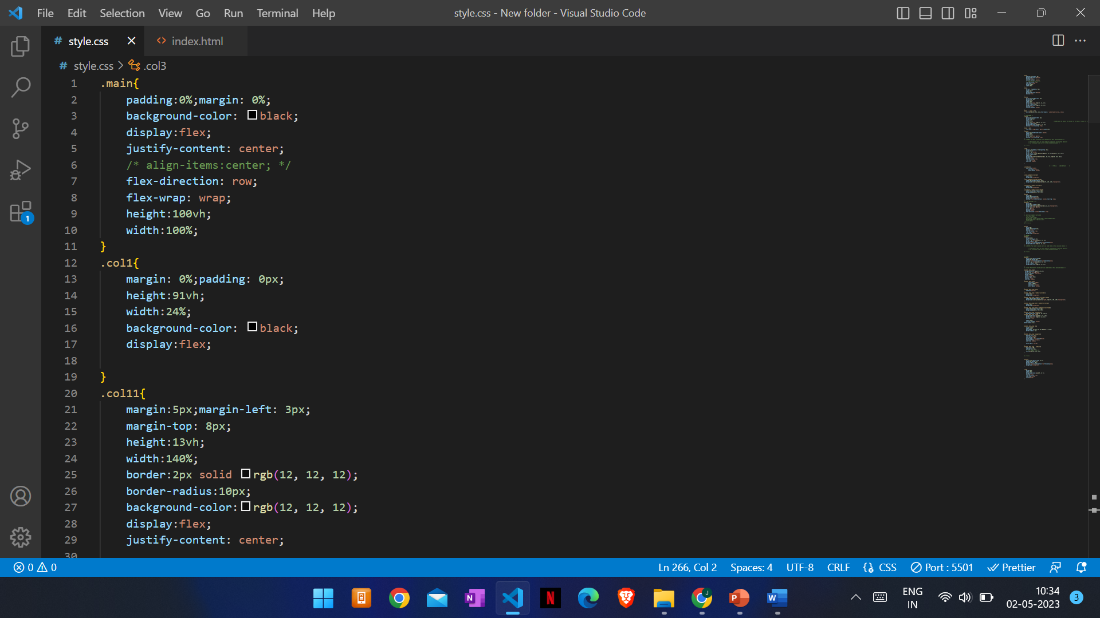

Slide 10
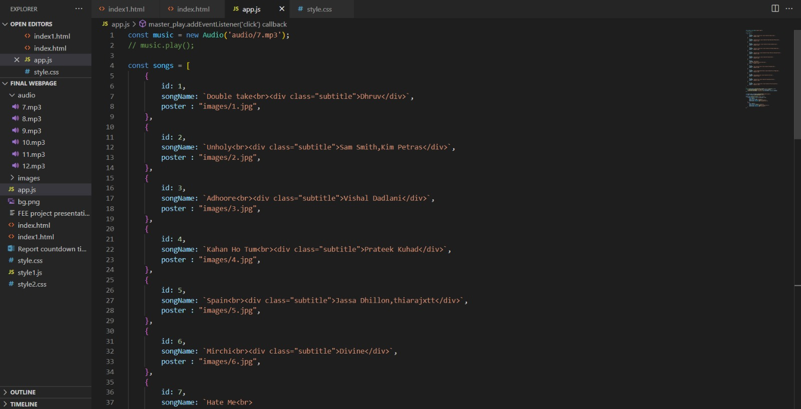
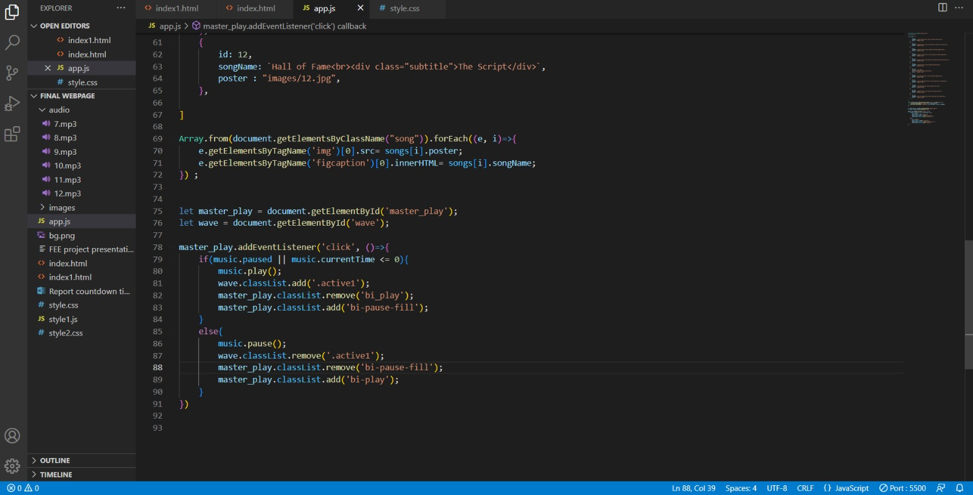
JAVA CODE:

Slide 11
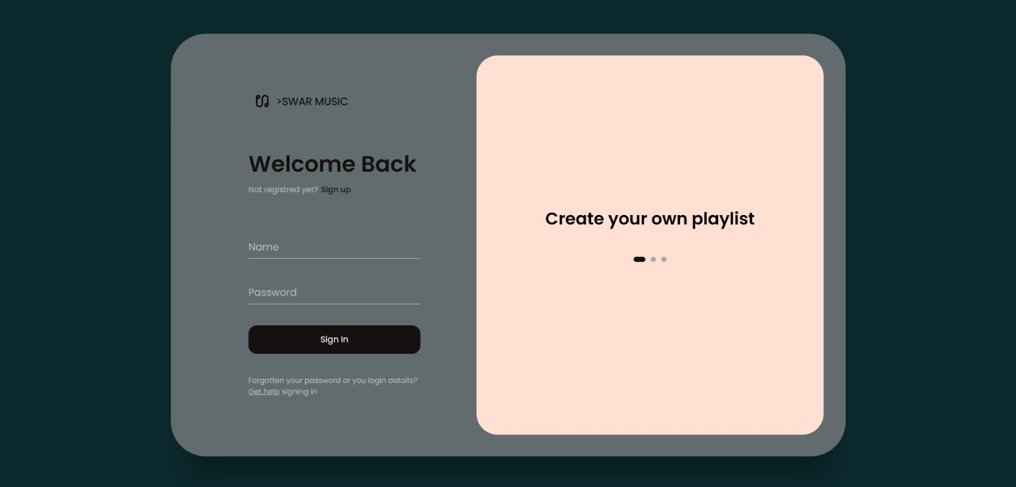
OUTPUT OF OUR CODE:
MULTIPLAYER

Slide 12
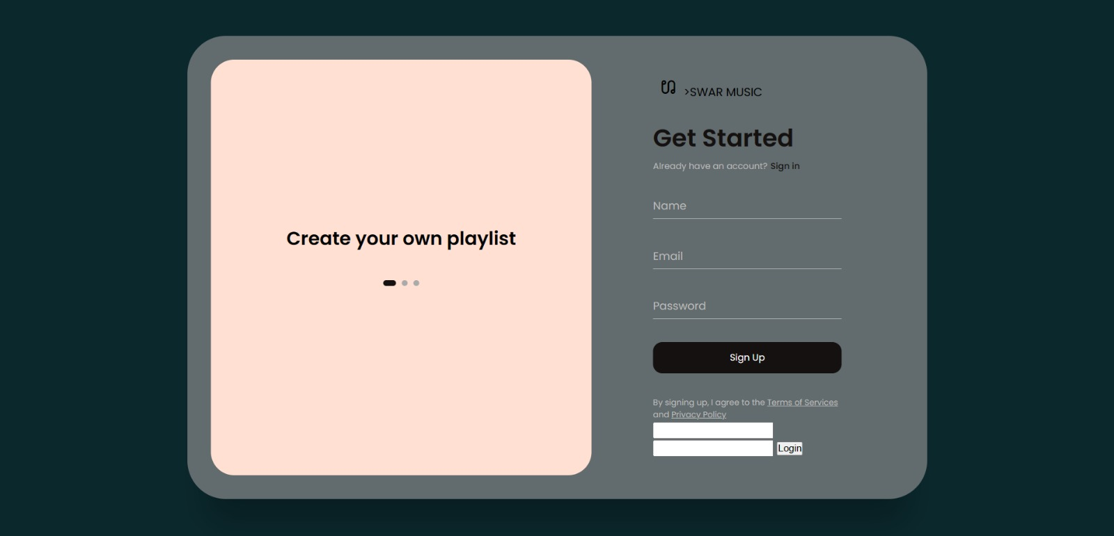

Slide 13
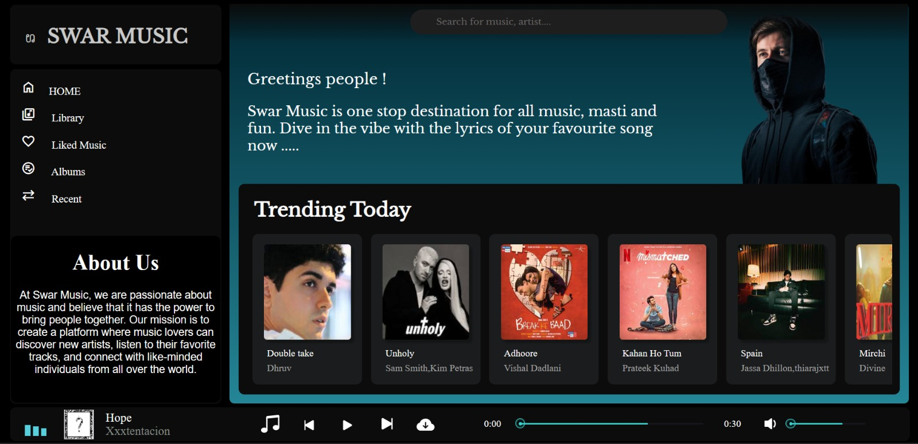

Slide 14
Bonus Features-
Our project provides a feature to store the user’s selected music albums as playlist so that they can enjoy their music anytime, anywhere.
We also keep records of their ‘recently played’ songs so that they can access their past played music and listen them again.
We provide a feature for ‘liked music’ which enables them to see all their selected liked music.

Slide 15
Conclusion-
The project was a music player, which involved
designing and developing software to play audio files on web.
Key features of Swar Music include -:
A user-friendly interface,
Support for different file formats,
Smooth transitions,
The ability to create and manage playlists,
Playback settings.

Slide 16
References/Links used
References of this project have been taken from the below mentioned sites-
https://music.youtube.com/
https://open.spotify.com/
https://www.jiosaavn.com/
https://music.apple.com/us/browse

Slide 17


